Slide 1
Web Scraping Project
Stephen Kita
NYC Data Science Academy
July 27, 2020

Slide 2
CVS Pharmacy
~10,000 stores in the United States
$256B in revenue in 2019
Top sources of income are pharmacy sales ($141B) and in-store sales ($86B)*
Majority of pharmacy sales are within the pharmacy network (in-store)
Increasing brick-and-mortar presence is still a viable way to grow revenue.
*CVS Health 2019 10-K SEC Filing.

Slide 3
CVS Pharmacy
Problem Statement:
Brick-and-mortar stores are a great way to increase revenue, but CVS is running out of new places to open stores.
Value Proposition:
CVS can identify new store locations by comparing current locations with regional population data.

Slide 4
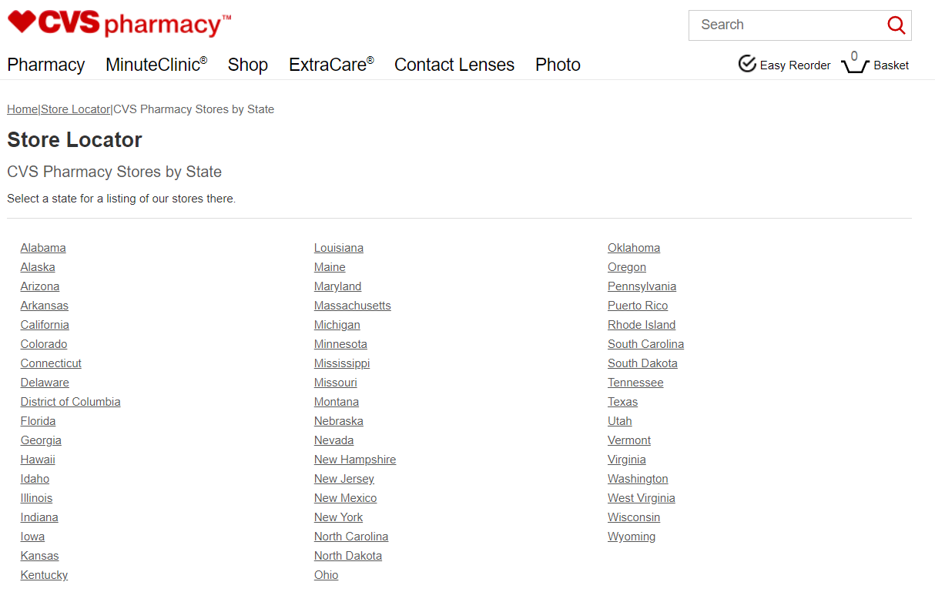
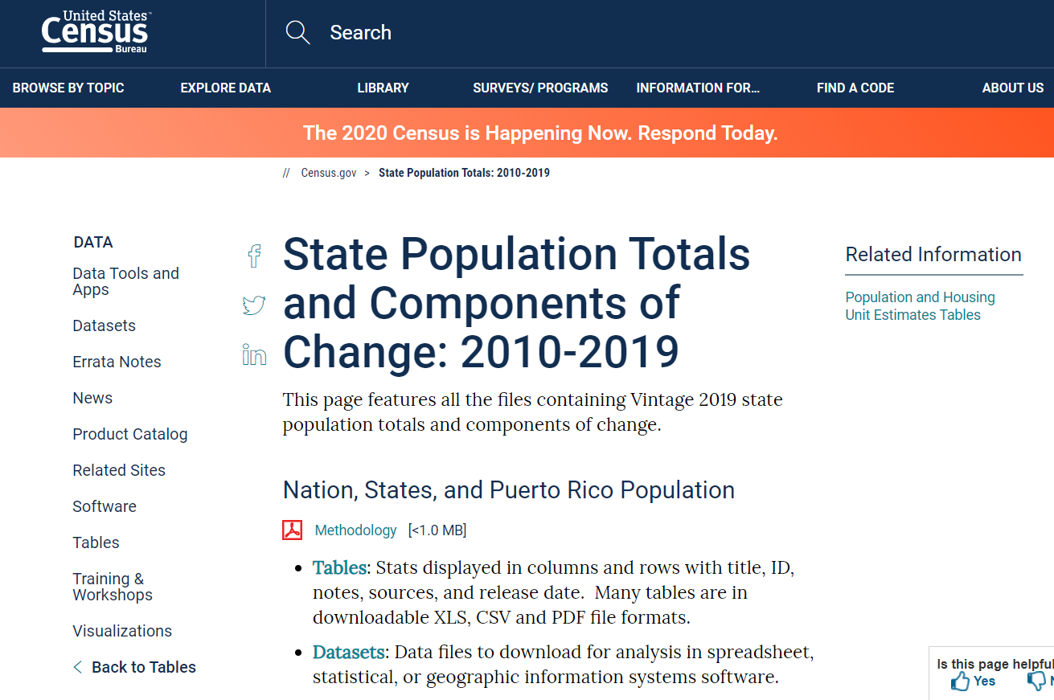
Data Gathering
CVS Store Locations online:
US Census data online:

Slide 5
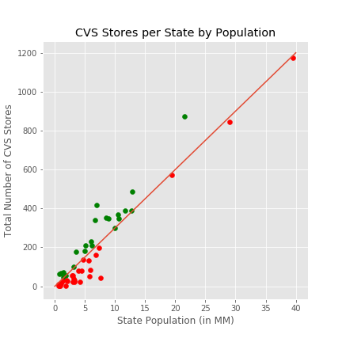
Data Analysis
States were grouped based on number of stores per person
On average, one store per 33,000 people
Some states are way below the average

Slide 6
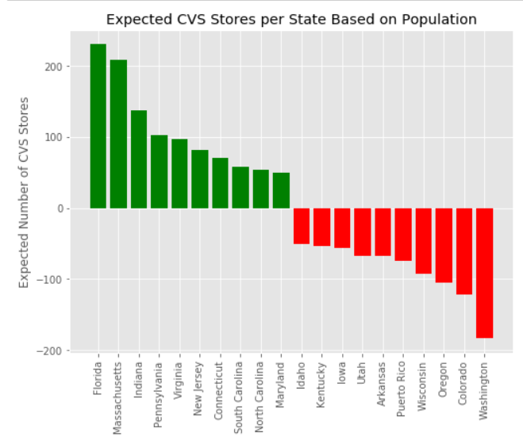
Data Analysis
Stores were grouped by:
Higher than average number of stores per person (green)
Lower than average (red)

Slide 7
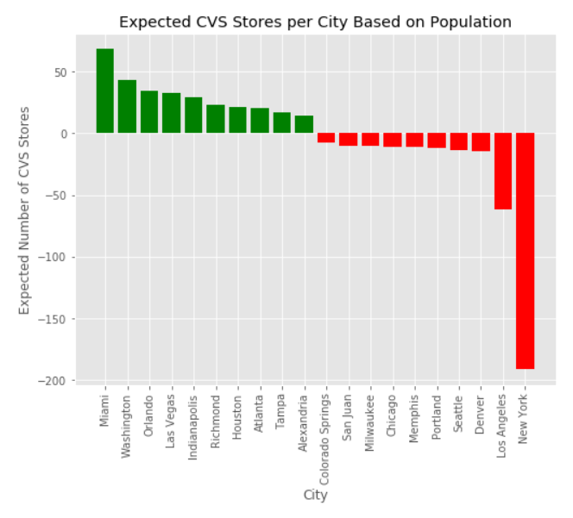
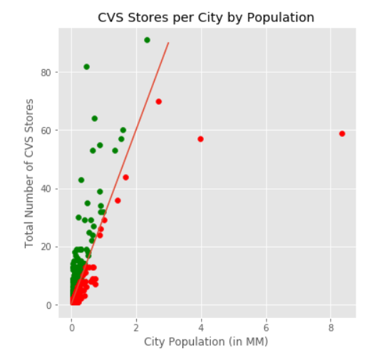
Data Analysis
Cities were group and analyzed the same way

Slide 8
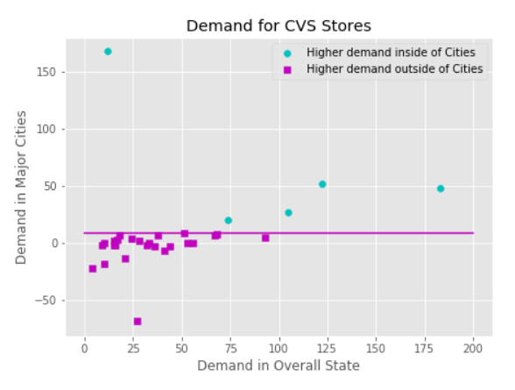
Data Analysis
Assumption: lower than average number of stores equates to higher demand
States were grouped a second time based demand for CVS in cities vs the state

Slide 9
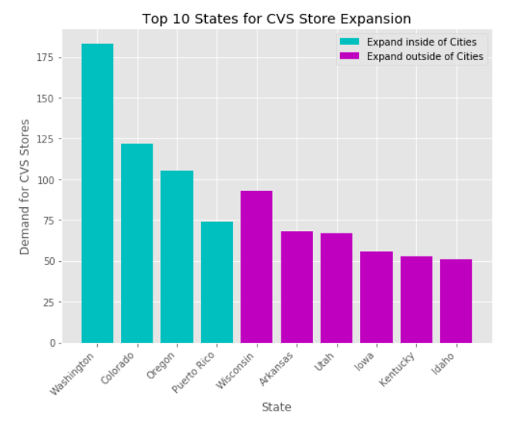
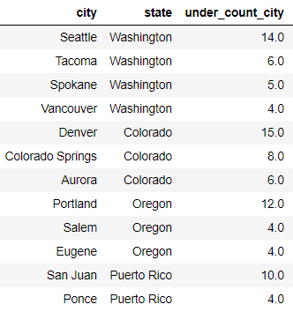
Results
Top Cities for Store Expansion
store_demand

Slide 10
Conclusion
Based on the current number of CVS stores per person, CVS still has opportunity to grow new stores
Recommend new stores in these cities:
Seattle, WA
Denver, CO
Portland, OR
San Juan, PR
Recommend new cities in these states:
Wisconsin
Arkansas
Utah
Iowa

Slide 11
Competitor Analysis
Walgreens facts
Walgreens financials

Slide 12
Competitor Analysis
Highlight cities where walgreens has less than expected presence

